Slide 1
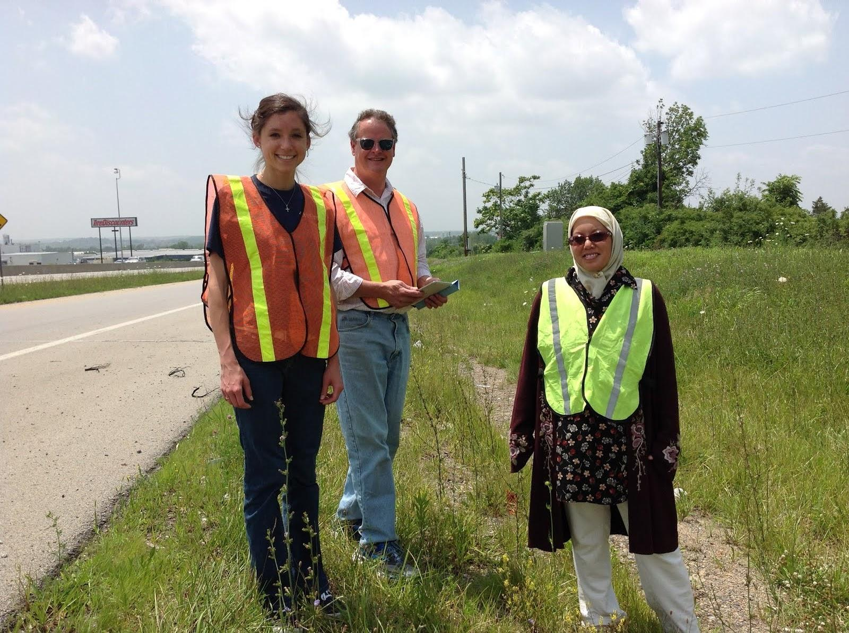
Ramp Metering Control for Mitigating Freeway Congestion
RET Group Presentation
Amy Gunderman, Biology and Physics, Finneytown High School
Bob Leugers, Geometry, School for the Creative & Performing Arts
Joanne Vakil, MS Math and Science, Dayton Islamic School

Slide 2
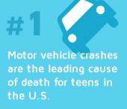
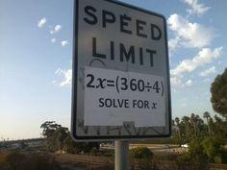
2
Notes:
In roughly a decade, very little progress has been made in decreasing the percentage of passenger vehicle occupant deaths occurring each year.
Greater areas of traffic congestion have been found to correlate with greater vehicular accident rates. HAVE AN INTERACTIVE ASPECT TO BEGINNING
RAISE OF HANDS, ETC
HOOK/ TRAFFIC BACKUP
AMUSEMENT PARK LINE

Slide 3
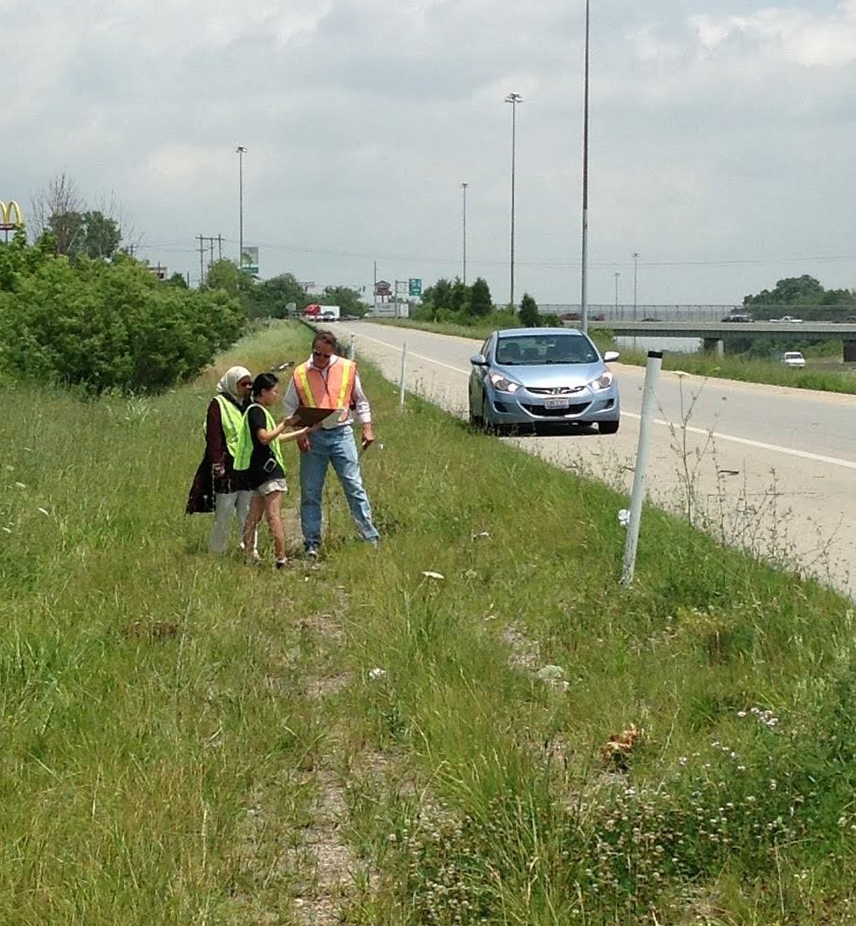
Table of Contents
Abstract / Introduction
Background Literature Review
Goals and Objectives
Tasks to be Undertaken
Timeline
Research Training
Evaluating Output
Unit Plans
References
3

Slide 4
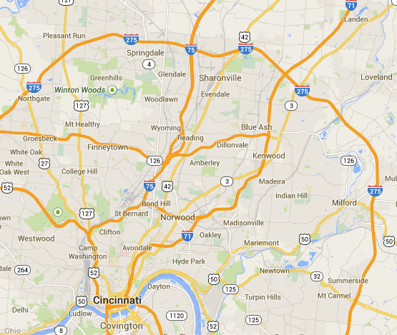
Causes of Congestion
4
Notes:
Point out WB (background) traffic is moving faster than EB. CAUSES OF CONGESTION describe the problem we see; show a picture of the congestion; show eastbound slowing down video

Slide 5
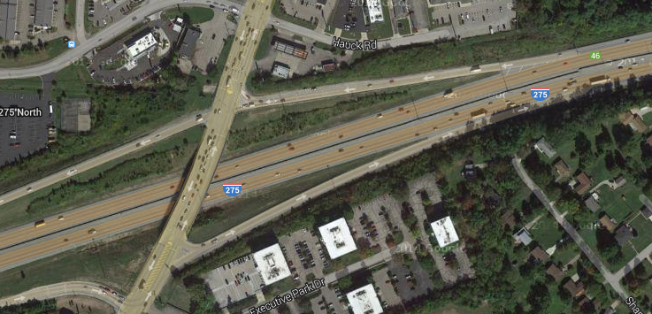
5

Slide 6
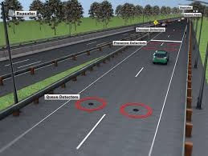
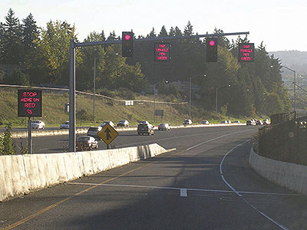
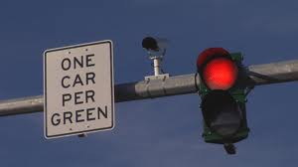
SOLUTION
6

Slide 7
GOALS AND OBJECTIVES
Ramp Meter Mechanics
Evaluation of Site Conditions
Modelling Alternatives
Analysis & Recommendations
7

Slide 8
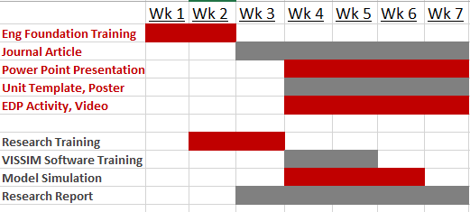
Timeline
8

Slide 9
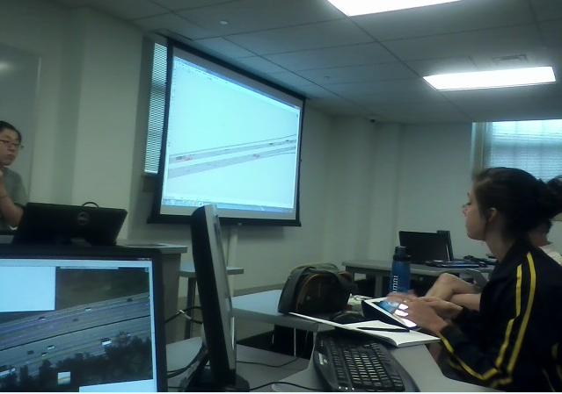
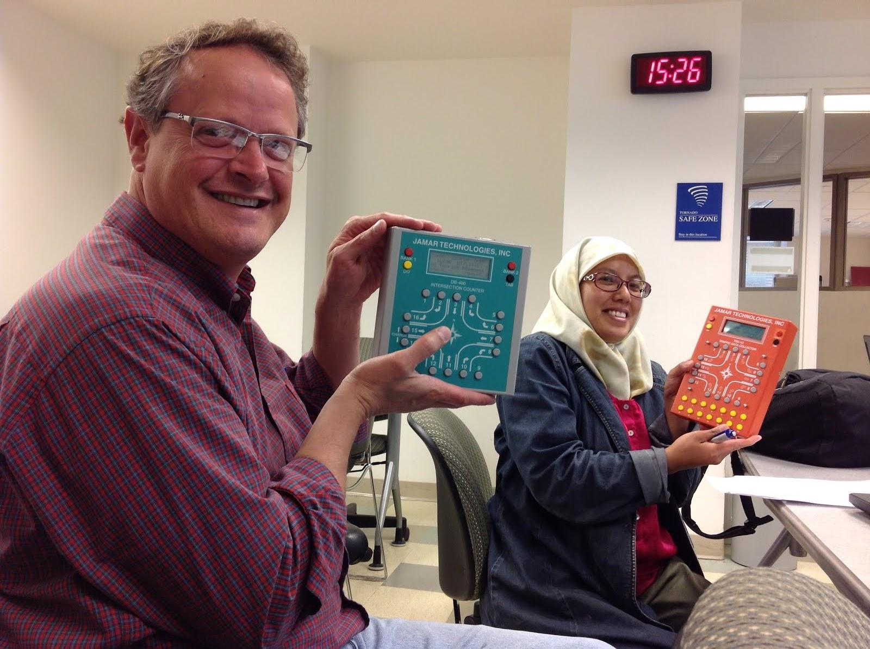
Research Training
Basic Ramp Meter Theory
Data Collection Methods
VISSIM Modelling
Evaluation
9
Notes:
When does ramp metering make sense?
Need a common language in order to understand the research and intricacies of ramp metering.
Maintain mainline flow, reduce accidents, reliability
A & B - no need, D & F - doesn’t help
Are there jurisdictional issues or ability to lengthen/widen the ramp or change grade, Equity, Driver behavior, Isolated meter or systematic
ramp vol > 900VPH, collision frequency > nearby ramps, existing RH lane flow > 2100VPH
Traffic Counts, speeds/location/time of day in entire area, Measurements of existing ramp
Cycle times, queue length, location of stop bar

Slide 10
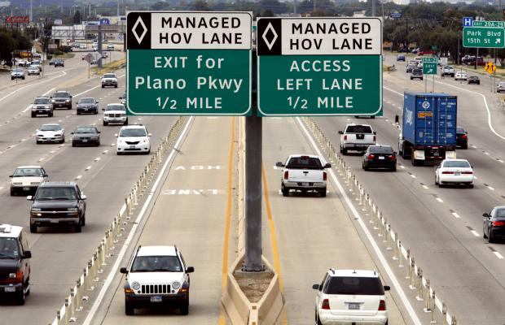
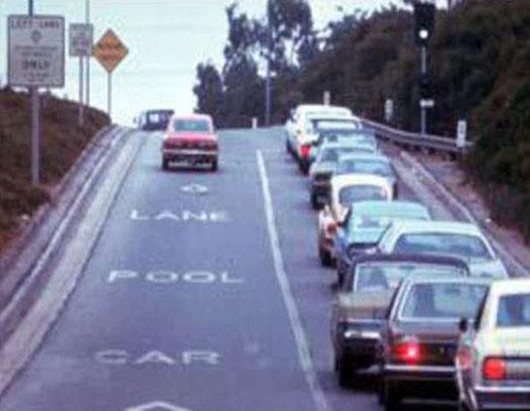
Background Literature Review
Ramp Meter History:
1950’s - 60’s
1980’s - 90’s Traffic-responsive
Over 2100 in US
Local streets to freeways
High-occupancy vehicle (HOV) bypass lanes
Not metered
Increases carpool rates
10
Notes:
The first Ramp meter in North America was simply a police office standing at a freeway entrance ramp, who would stop vehicles and release them for entry at a pre-determined rate. Also used widely in other countries too

Slide 11
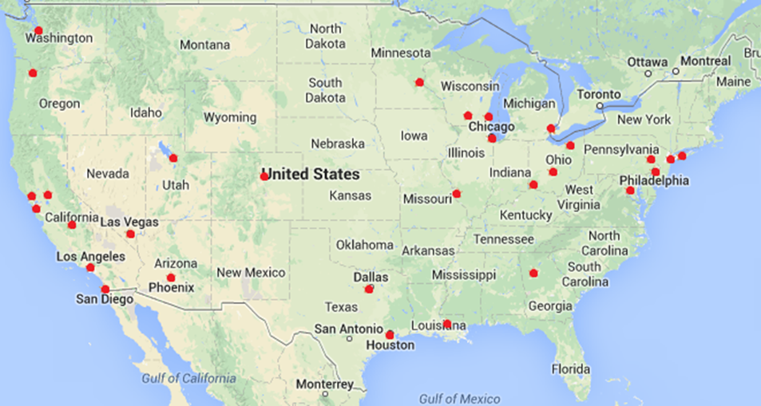
As of 2009, ramp metering was implemented in 30 US cities.
11
Notes:
In Ohio, there are ramp meters in the Cleveland, Columbus, and recently the Cincinnati area.
The Cincinnati ramp meters are located along east-bound Interstate 74, from North Bend road through Spring Grove Ave.

Slide 12
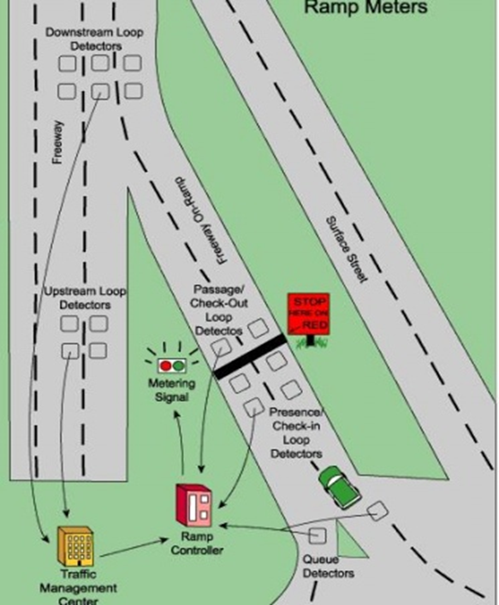
So, How Does a Ramp Meter Work?
Ramp Metering System
Metering Signal
Ramp Controller
Detectors
TMC
12
Notes:
Metering Signal: Indicating to drivers when they can enter the ramp using a green light (go) and red light (wait)
Ramp Controller: Controls ramp metering rate
Detectors: vehicle count, speed, and freeway occupancy
Traffic Management Center: Collects vehicle presence information of upstream, downstream and at ramp entrance (i.e., queues). TMC and detectors are only part of the traffic-responsive ramp meter systems.
***We are focusing on the Fixed-time ramp meters for our study site, so TMC and detectors will not be involved.

Slide 13
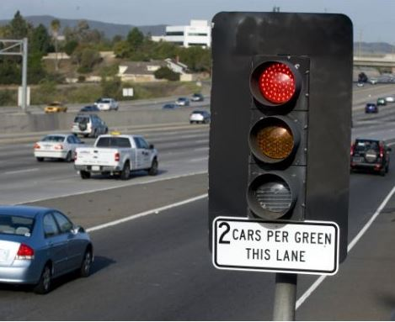
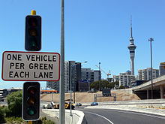
Metering Design
13
Notes:
These charts display the standard recommendations by the Federal Highway Administration. (Bottom chart): Our study site entrance ramp volume is in the 500 < RV < 900 range, so we developed two scenarios. One is single lane and the other is dual lane. (Point to top chart): We used the 2 gray levels of chart 1.

Slide 14
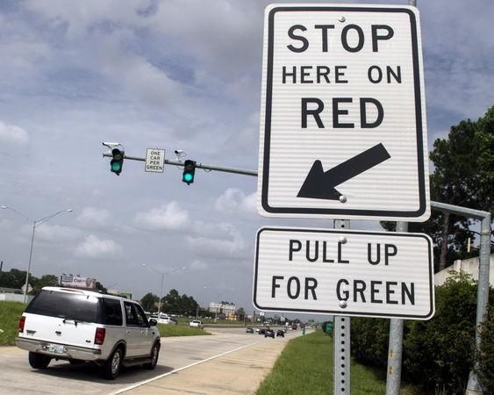
Signal Head Placement
Depends on:
Length needed for acceleration
Sufficient queue length
Number of lanes
14
Notes:
Queue storage length is incredibly long, we can add an additional lane to shorten the queue length. Length needed for acceleration depends on the desired merging speed and the incline of the entrance ramp.

Slide 15
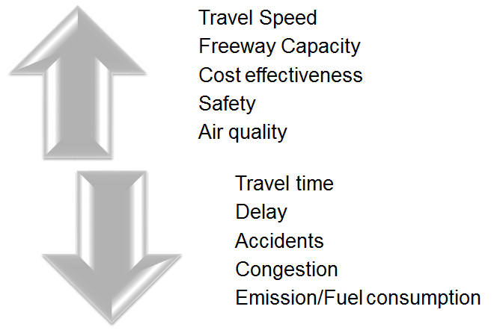
Positive Impacts
15

Slide 16
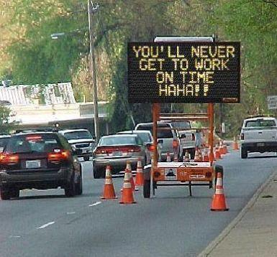
Negative Impacts
Traffic diversion
Increased on-ramp delay, emissions and fuel consumption
Costs
Spillback
But all of these impacts can be resolved through other measures.
16
Notes:
Traffic diversion to local streets; Increased on-ramp delay, emissions and fuel consumption; Costs of installation, maintenance, enforcement & public relations; SPILLBACK, But we can otherwise solve these

Slide 17
When Should A Ramp Meter...
...be used?
To solve congestion issues during peak hours
To decrease accidents
To improve the level of service on the freeway
...not be used?
during non-peak hours
when geometry issues exist
insufficient queue length
too steep incline
too short ramp
17
Notes:
Geometry issues (ramp isn’t long enough….need enough length, taking into account incline as well, to allow appropriate accelerate after the signal head. Also, there needs to be enough room for cars to queue without spilling back onto local streets. In some instances, the geometry of the ramp can be altered (whether it is by lengthening the ramp, adding a lane, etc), but then it becomes a cost / benefits issue.

Slide 18
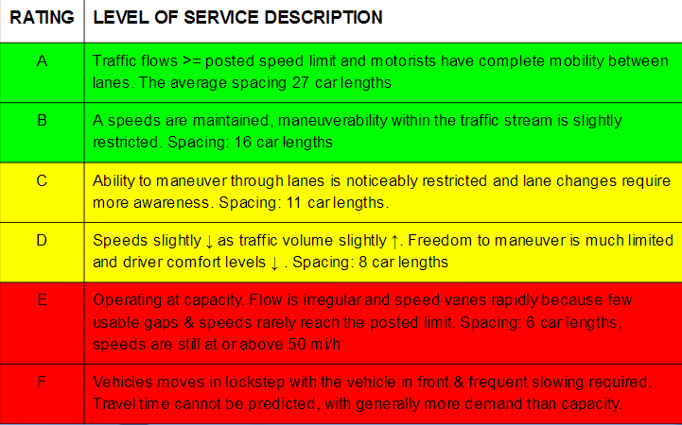
18
Notes:
The Level of Service rating is used to analyze highways by categorizing traffic flow and assigning quality levels of traffic based on performance measure like speed, density,etc. The ratings provided range from A-F, with A having the best traffic flow, steady speeds, easy lane changes, and good safety distances. And F having irregular speeds, overcrowding on the freeway, and an inability to change lanes. In the C,D and occasionally E levels of service, ramp meter implementation is extremely helpful. In levels A and B, a ramp meter is not needed because traffic flow is already near optimal level. In levels E and F, traffic is so greatly congested that a ramp meter will not be of any assistance.

Slide 19
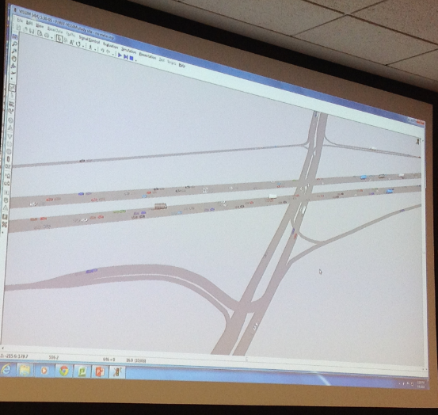
How Do We Know the Effects of Implementation? Why Conduct a Study or Simulation?
Cannot just install a ramp meter as an experiment in the real-world
Instead, we can create a simulation
Used to model the “what if” scenarios
Do not spend the money if it will not help
19

Slide 20
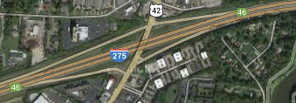
Requirements to Build Simulation
Speed
Vehicle Count
VISSIM
Model
Validate
Simulate
Site Geometry
Site Survey
Google Maps
20

Slide 21
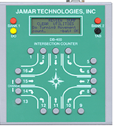
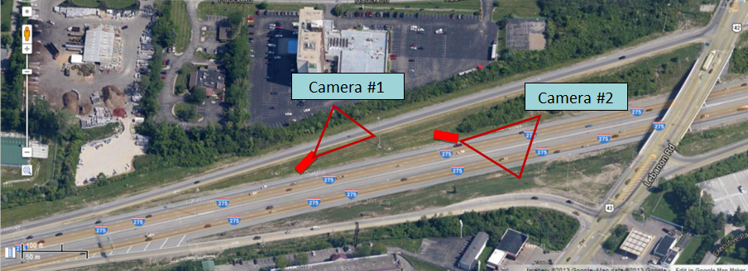
Data Collection
21
Notes:
Traffic Counter: a device used to count the traffic in the freeway and on the ramps, The counter has to be manually pressed each time that a vehicle is noticed on the entrance ramp. Video was taken and used with the traffic counter to record vehicles and distinguish between cars and trucks. GPS Receiver Device: used to track the second by second trajectory data and is used to determine the speed and acceleration distributions of the simulation network.
This image only depicts the WB, however we repeated the same data collection for the EB as well.

Slide 22
How Was The Collected Data Used?
Calibration and Validation in VISSIM
Input collected data into VISSIM (Calibration)
VISSIM output vs real-world data (Validation)
Match = validated model
22
Notes:
Traffic volume gathered from video data collection.
Speed and travel time from GPS Data collection.
We validated traffic volume, speed, and travel time

Slide 23
Modeling in VISSIM
VISSIM
Model
Validate
Simulate
Parameter | Value
Mainline Volume | 6295
On Ramp Volume | 804
Car Desired Speed Dist. | 55-70
HGV Desired Speed Dist. | 53-68
Veh. Composition (Car) | 95%
Veh. Composition (HGV) | 5%
23
Notes:
Calibration = (Input: volume, speed distribution, vehicle composition, priority rules, route decision,) (address order of importance)

Slide 24
Validating in VISSIM
VISSIM
Model
Validate
Simulate
Model Must Reflect Actual Traffic Performance
Driving Behavior Parameters
acceleration rate
stand-still distance
headway
24
Notes:
Validation= adjust driving behavior parameters; then run the simulation(max/min acceleration rate, and stand-still distance (when traffic stopped, distance from front bumper to rear bumper); headway (time for front of car 2 to pass the same point that car 1 passed earlier), spacing on the ramp

Slide 25
Validating in VISSIM
VISSIM
Model
Validate
Simulate
How do we know if model is valid?
VISSIM Output vs Collected Data
speed
travel time
volume
25
Notes:
Validation= adjust driving behavior parameters; then run the simulation(max/min acceleration rate, and stand-still distance (when traffic stopped, distance from front bumper to rear bumper); headway (time for front of car 2 to pass the same point that car 1 passed earlier), spacing on the ramp

Slide 26
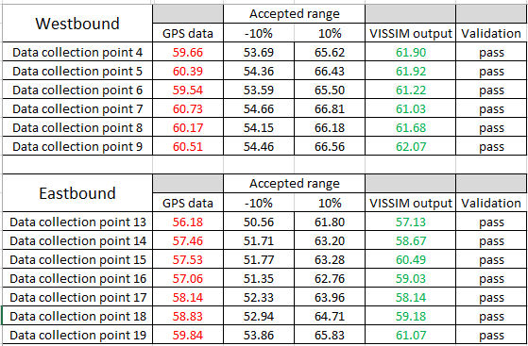
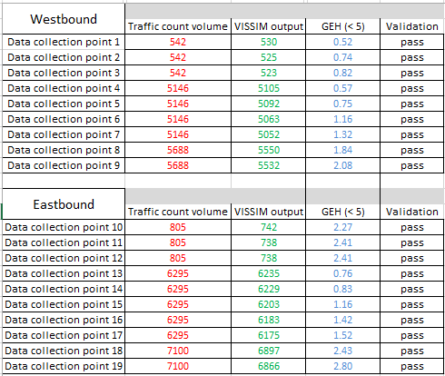
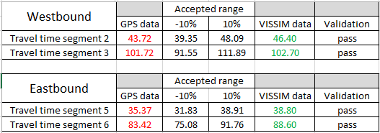
Validating Speed Data
PASSED
PASSED
PASSED
26
Notes:
POINT to where we got the data collection points Physically point to columns; HIGHLIGHT
WHAT does it mean now that the validation passed? define

Slide 27
Based on Validated Model
Insert ramp meter in VISSIM
Scenario 1 Single Entry Ramp
Scenario 2 Dual Lane Ramp
Simulation in VISSIM
VISSIM
Model
Validate
Simulate
27
Notes:
This becomes our baseline model that reflects the freeway/ramp system as it exists now; from this we can model an infinite number of possibilities but we want to focus on the two scenarios defined in our research plan.

Slide 28
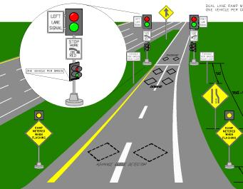
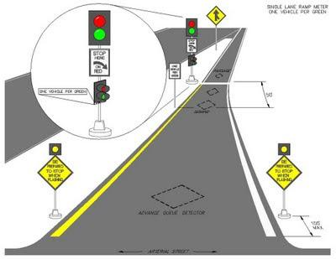
Single & Dual Lane Ramp Meters
Simulation in VISSIM
VISSIM
Model
Validate
Simulate
Lane | 1
1 sec | 2 sec |  | 3 seconds
Lane | 2
4 seconds |  |  |  | 2 sec
6 seconds
28
Notes:
Describe the operation of a single lane and dual lane ramp meter. Talk about the signal timing plans for each scenario.(cycle length and green interval) (see PPT "RET project 5 - basics of ramp metering 3", slides 21, or PPT "RET project 5 - basics of ramp metering 3)
Based on FHWA criteria, for our Scenario #1, we design a 4-second cycle time with 2 seconds green interval and 2 seconds red time. Dual ramp is 6-second cycle w/ each lane having staggered 2 second green

Slide 29
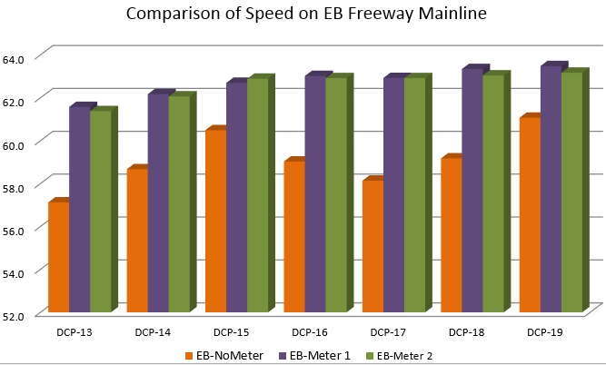
Eastbound Simulation Results
29
Notes:
TAKE TIME TO SHOW GRAPH up and down at first; after more fluid and consistent “Increased speed by an average of 4%”
THE BLUE SHOWS RELIABILITY; NOT MUCH VARIABILITY

Slide 30
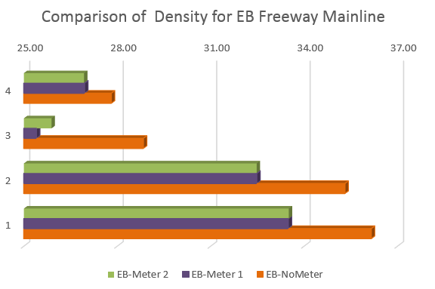
Eastbound Simulation Results
D ⇒
E ⇒
30
Notes:
TAKE TIME TO SHOW GRAPH up and down at first; after more fluid and consistent “Increased speed by an average of 4%”
THE BLUE SHOWS RELIABILITY; NOT MUCH VARIABILITY

Slide 31
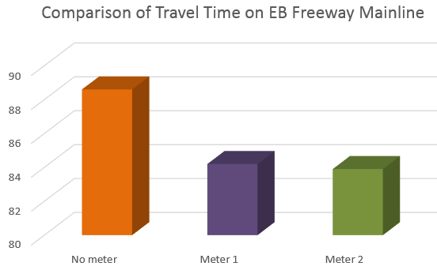
Eastbound Simulation Results
10,000 hrs./yr.
31
Notes:
TAKE TIME TO SHOW GRAPH up and down at first; after more fluid and consistent “Increased speed by an average of 4%”
THE BLUE SHOWS RELIABILITY; NOT MUCH VARIABILITY

Slide 32
Eastbound Recommendations
A Dual Lane Ramp Meter
Fixed Signal Time Plan - Staggered
Benefit
Growth
Ramp Length
32
Notes:
The vehicle speeds are comparable to the single lane ramp but the max queue length risks spillback onto the surface road.

Slide 33
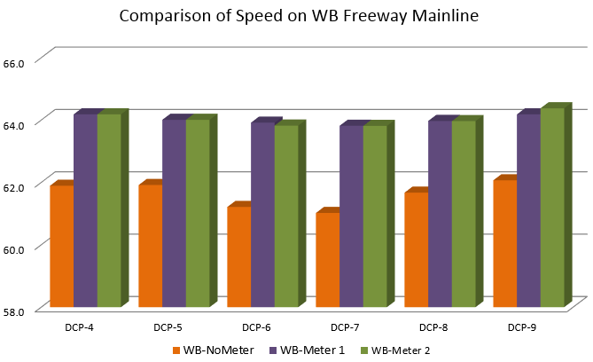
Westbound Simulation Results
33
Notes:
TAKE TIME TO SHOW GRAPH up and down at first; after more fluid and consistent “Increased speed by an average of 4%”
THE BLUE SHOWS RELIABILITY; NOT MUCH VARIABILITY

Slide 34
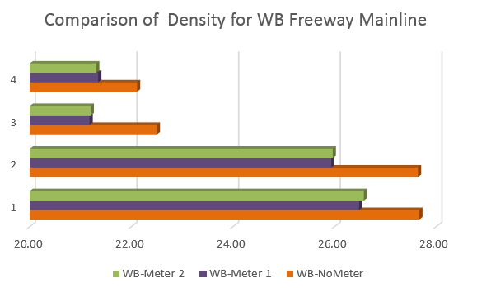
Westbound Simulation Results
D ⇒
34
Notes:
TAKE TIME TO SHOW GRAPH up and down at first; after more fluid and consistent “Increased speed by an average of 4%”
THE BLUE SHOWS RELIABILITY; NOT MUCH VARIABILITY

Slide 35
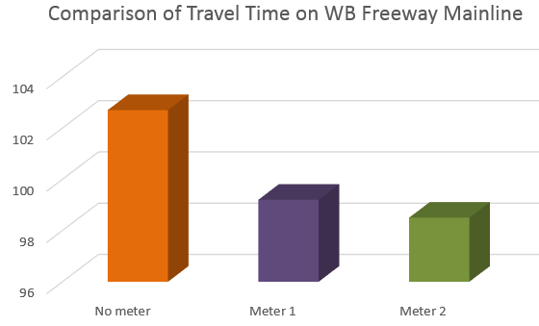
Westbound Simulation Results
35
Notes:
TAKE TIME TO SHOW GRAPH up and down at first; after more fluid and consistent “Increased speed by an average of 4%”
THE BLUE SHOWS RELIABILITY; NOT MUCH VARIABILITY

Slide 36
Westbound Recommendations
A Single Lane Ramp Meter
Fixed Signal Time Plan
Benefit
Growth
Ramp Length
36
Notes:
The vehicle speeds are comparable to the single lane ramp but the max queue length risks spillback onto the surface road.

Slide 37
Meeting Goals & Objectives
Ramp Meter Mechanics
Evaluation of Site Conditions
Modelling Alternatives
Analysis & Recommendations
37

Slide 38
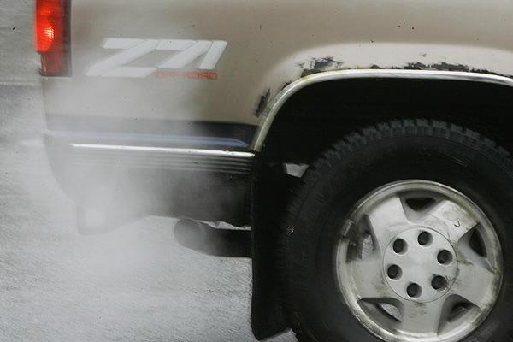
Future Research
Systemwide Meters, Emissions, HOV Bypass
38
Notes:
Can ramp meters be used in public policy as a means to reduce atmospheric pollutants or fight global warming.

Slide 39
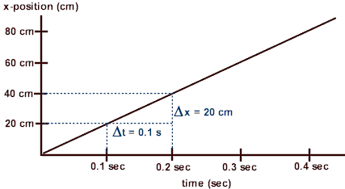
Amy’s Current Unit Progress
Unit Topic: Velocity and Acceleration
Big Idea: Ramps
Essential Questions:
How can we use physics to design an ideal ramp for a specific location or to fit a specific need?
39

Slide 40
Amy’s Current Unit Progress (cont.)
Why Acceleration and Velocity?
Read, construct, and analyze motion graphs
College entrance exams
Required standardized assessment prior to graduation:
Ohio Graduation Test (OGT) to end of course exam for Physical Science.
2013-14: Indicator for science (70.6%) not met.
2013-14: Indicator for math barely met (76.1%).
40

Slide 41
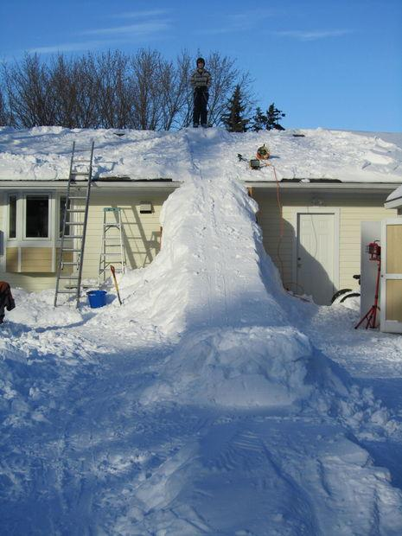
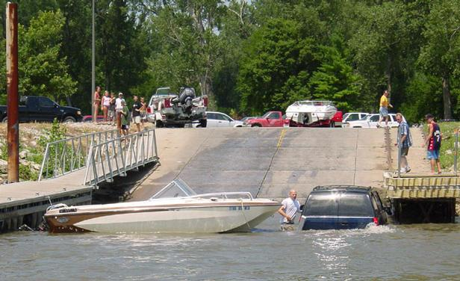
Lesson 1: Activity 1
Youtube videos of ramp bloopers
think - pair - share
Generate essential Questions
Generate Challenge
41

Slide 42
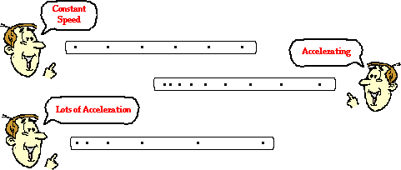
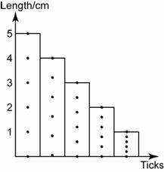
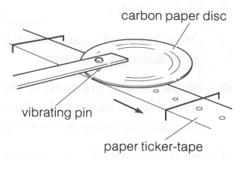
Lesson 1: Activity 2
Ticker-tape Motion Activity
42

Slide 43
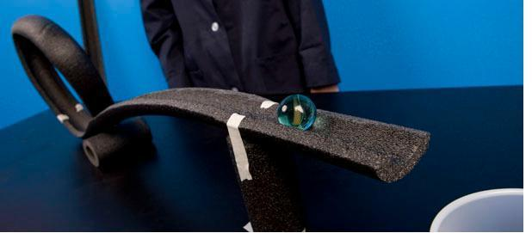
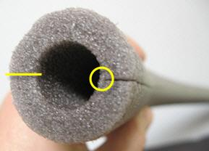
Lesson 2: Activity 3
Foam insulation activity to determine the relationship between mass, incline, and ramp length
43

Slide 44
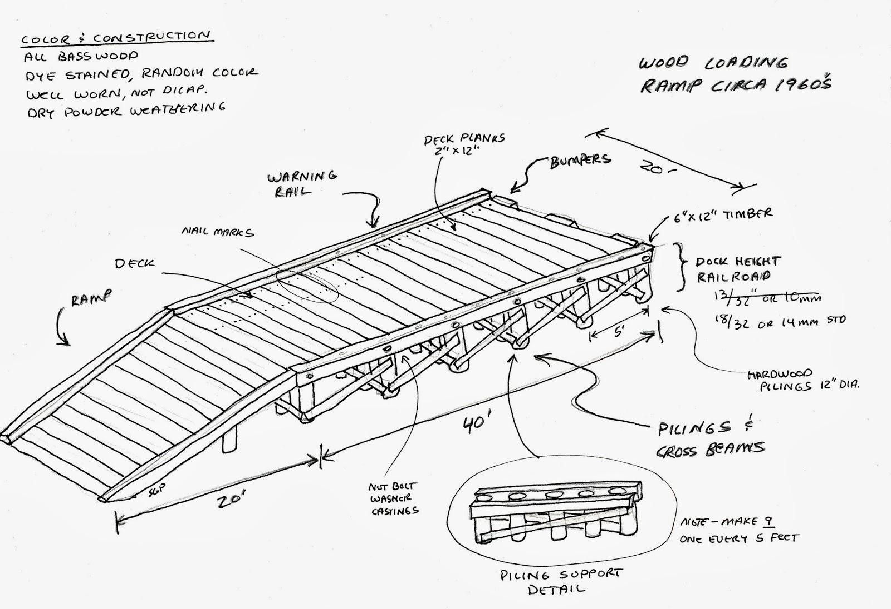
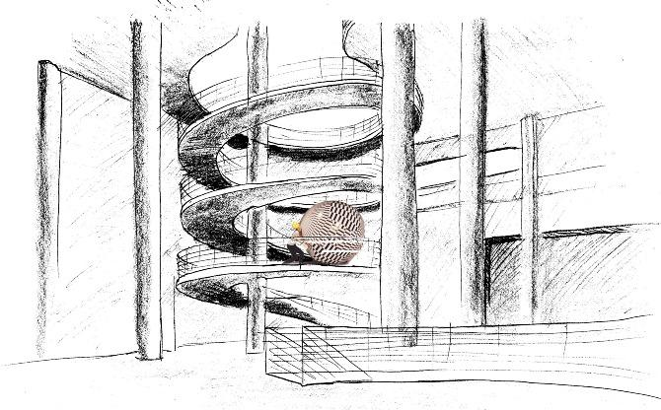
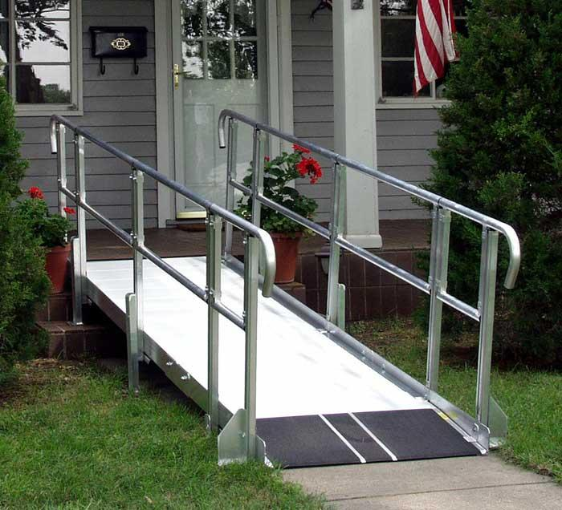
Lesson 2: Activity 4
Challenge:
Propose a ramp that you believe is needed at a specific location.
Include:
sketch / labeled diagram
detailed description
justification
3 graphs
(position vs time, velocity vs. time, and acceleration vs time).
44

Slide 45
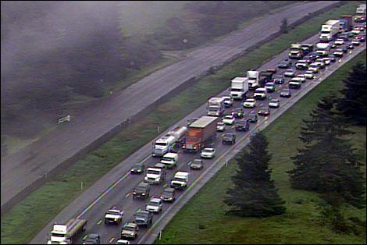
Bob’s Current Unit Progress
Unit Topic: Customer Service Models
Big Idea: Wait time
Essential Question:What variables impact wait time and how can they be manipulated to provide optimal service?
45

Slide 46
Lesson 1 Activity 1
Identify problem
Research
Prototype
46
Notes:
Identify problems related to traffic congestion, Research to find primary factors, Prototype manipulating only 2 variables

Slide 47
Lesson 2 Activity 2
10 total variables
Refinement
47
Notes:
Refine by manipulating 6 variables, Communicate solutions

Slide 48
Lesson 2 Activity 3
Challenge: Design a system that will serve 60 customers food in a 15 minute period with no one having to wait more than 5 minutes.
48

Slide 49
Lesson 2 Activity 4
Prototype
Refine
Challenge
49

Slide 50
Joanne’s Unit
Big Idea: Force, Motion, and Math Have an
Impact on Traffic Management
Essential Question: What is the most efficient and
optimal route for cars to travel in a congested area?
Unit Topic: Stop and Go!
Designing an Efficient Route to Help Reduce Gas Consumption
50

Slide 51
Lesson 1: Activity 1
Data Day: Determining Data Dominance
Addressing Domain 5 Common Core Math Standards
outlier
mode
MAD
median
mean
bias
minimum
population
maximum
sample
54

Slide 52
Lesson 2: Activity 2
Data Day: Guzzling Gas
Addressing Domain 5 Common Core Math Standards
Hook: The U.S. uses approximately half of the world’s gasoline -- 134.51 billion gallons of gasoline were consumed.
Idling in traffic alone utilizes over 8 million gallons
of gasoline per day!
52

Slide 53
Lesson 2: Activity 3
Don’t Overreact: Reaction Time and Other Driver Behavior Issues on the Road:
Ruler Drop Test
55

Slide 54
Lesson 2: Activity 4
CHALLENGE:
Design a model that will show the most efficient traffic management system (an intersection with a stop sign or stop light, or a roundabout), given a set of constraints.
53

Slide 55
References
Abdelfatah, A., Ramadan, A., and Darwish, G. (2012). “Utilizing vissim to evaluate ramp metering
performance.” International Journal of Traffic and Transportation Engineering, 1(1), 1-6.
Cambridge Systematics, Inc., (2001). “Twin Cities Ramp Meter Evaluation,” HF2891, Minnesota
Department of Transportation, St Paul MN.
Chaudhary, N. A. and Messer, C. J. (2000). “Design Criteria for Ramp Metering: Appendix to TxDOT
Roadway Design Manual.” FHWA/TX-01/2121-3, Texas Transportation Institute, College Station,
TX.
E. D. Arnold, Jr. (1998). “Ramp Metering: A Review of the Literature,” VTRC 99-TAR5, Virginia
Transportation Research Council, Charlottesville, VA.
Fang, J., Zhang, D., Jin, P., Qiu, Z., and Ran, B. (2012). “A case study of active traffic control: improving
efficiency of the traffic operations using ramp metering system.”
CICTP 2012: Multimodal Transportation Systems—Convenient, Safe, Cost-Effective, Efficient,
American Society of Civil Engineers, Reston, V.A., 3620-3632.
Gyejo, K., Lee, S., and Choi, K. (2004). “Simulation-based evaluation for urban expressway ramp
metering:a madison beltline case.” KSCE Journal of Civil Engineering, 8(3), 335-342.
Hasan, M. and Bajwa, S. (2013). “Evaluation of mitigation schemes to reduce hazardous conditions on
freeway during peak periods using micro-simulation.” Road and Transport Research, 22(4),
43-55.
56

Slide 56
References (cont.)
ITS Engineers and Constructors, Inc., (2003). “Ramp Meter Design, Operations, and Maintenance
Guidelines,” T01-59-I0123, Arizona Department of Transportation, Casa Grande, AZ.
Thompson, W. (1974). “Allocation of freeway ramp metering volumes to optimize corridor performance.”
IEEE Transactions on Automatic Control, 19(3), 177-186.
Tsubota, Y., Iwata, M., and Kawashima, H. “Evaluation study of inflow traffic control by ramp metering on
Tokyo metropolitan expressway,” thesis.
Yang, J. and Wu, Z. (2012) “Analysis of on-ramp metering strategies on urban freeway based on capacity
constraints.” Twelfth COTA International Conference of Transportation Professionals, Beijing, China 510-519.
Yu, B., Liu, C., Wang, Z. (2014). “Development of a computer system for simulation of traffic models.”
Journal of Computing in Civil Engineering, 28(2), 223-231.
57

Slide 57
The RET program funded by the National Science Foundation, Grant ID# EEC-1404766
Project Faculty Mentor, Dr. Heng Wei
Graduate Research Assistant, Ms. Bei Zhao
RET Project Director and Principal Investigator, Dr. Anant R. Kukreti
Resource Person & Grant Coordinator, Debbie Liberi
RET Resource Teacher, Steve Geresy
57

